Slide 1
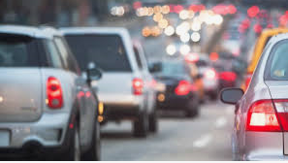
Finance
Travel

Slide 2
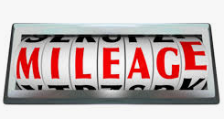
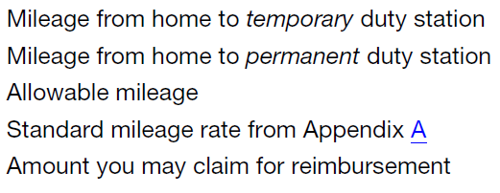
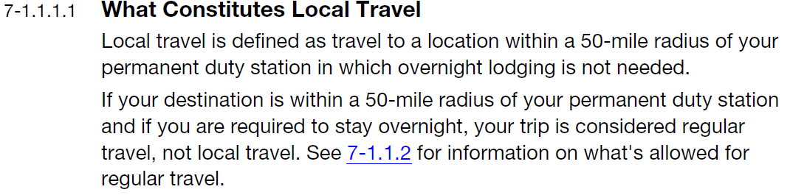
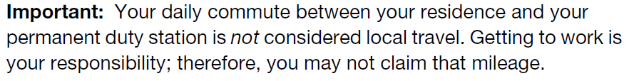
Mileage compensation is covered in the F-15 Handbook, Chapter 7.

Slide 3

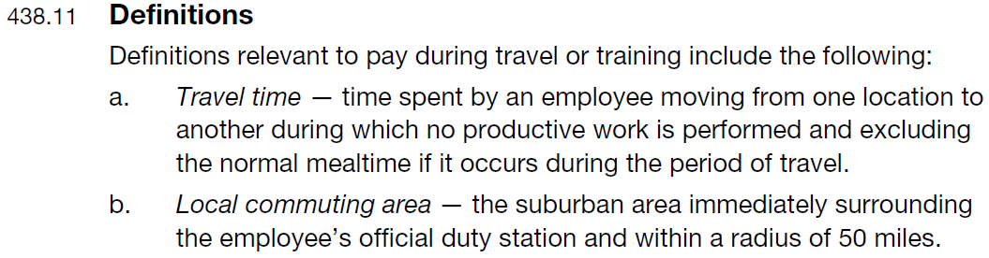
Travel time compensation is covered in the ELM, Section 438: Pay During Travel or Training, and for PTF clerks, in the 2017 Joint Contract Interpretation Manual (JCIM) under Q&A PTF Clerks Working in Other Installations

Slide 4
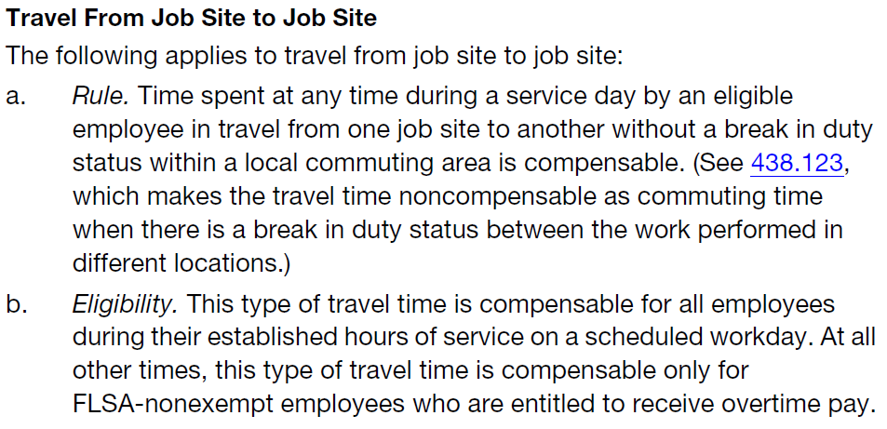
ELM 438.132

Slide 5
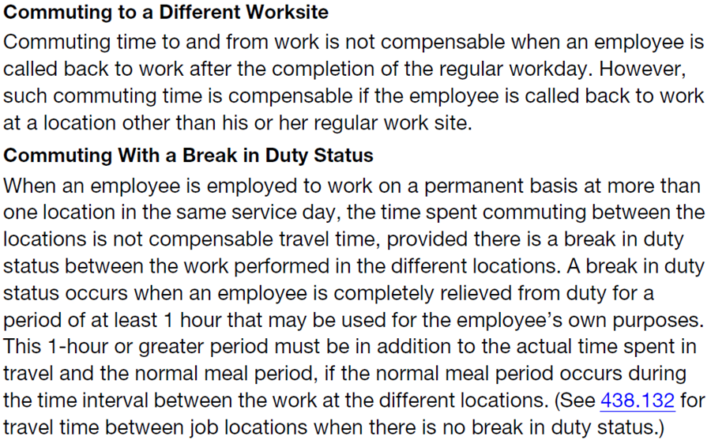
ELM 438.122

Slide 6
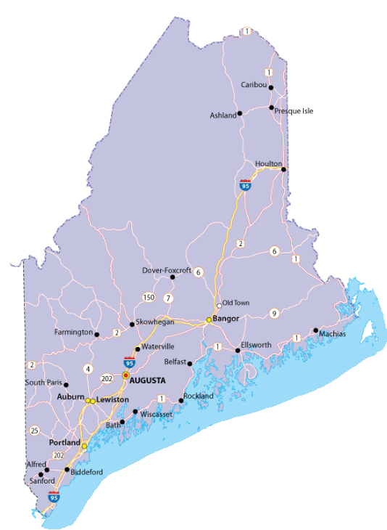
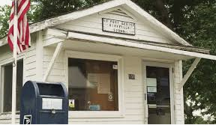
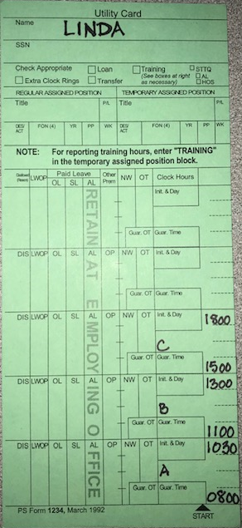

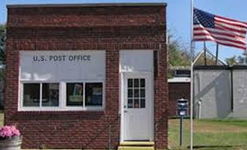
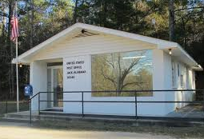
PTF Clerk Linda is scheduled to work at office A, her official duty station, on Monday from 8:00 – 10:00. She is not entitled to paid time or mileage to get there.
C
After closing office C, Linda drives home. Her home is located 60 minutes and 60 miles from office C. Because she is travelling more than 50 miles, she is entitled to the time and mileage (minus her regular commute) that it takes her to travel home.
Home
B
A
While Linda is working at office B, she gets a phone call from office C. They need her to close their office from 15:00 – 17:00, due to an employee calling out sick. Linda’s Postmaster agrees to loan her to office C. Office C is 20 minutes and 20 miles from office B. Linda is not entitled to pay for the travel time, because she will have more than 1 hour break in addition to the travel time between the two offices. She is entitled to mileage from office B to office C.
Linda is then scheduled to cover the lunch break at office B from 11:00 – 13:00. Office A and office B are 30 minutes and 30 miles apart. Linda drives to office B, then takes her lunch at 10:30. She is entitled to pay for the 30 minutes of travel time, as well as the mileage for the 30 miles between the two offices.

Slide 7

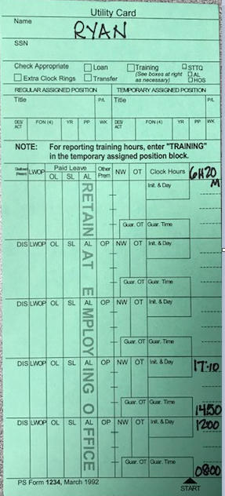




PTF Clerk Ryan is scheduled to work at office A, his official duty station, on Monday from 8:00 – 12:00. He is not entitled to paid time or mileage to get there. He lives 10 mile and 10 minutes from office A.
Ryan completes his work and leaves for the day.
At 13:00, Ryan gets a call from his Postmaster, informing him that he is needed at the office B from 15:00 – 17:00. Office B is 10 minutes and 10 miles from office A.
Ryan reports for work at 15:00 at office B. Because he was called back after his end tour to an office other than his official duty station, he is entitled to travel time.

